Slide 1
Clime and Meteorogical Data Comparison Ciudad Real – Málaga Airport

Slide 2
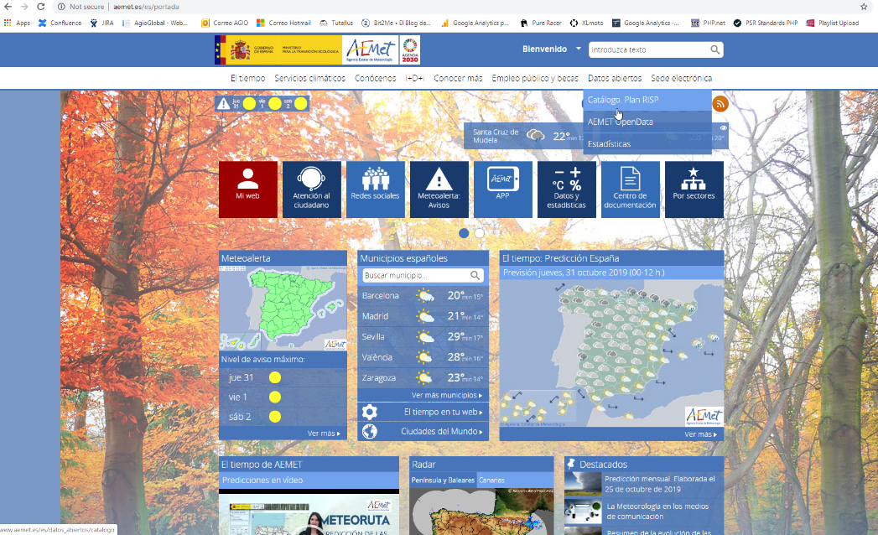
Go to aemet/datosabiertos

Slide 3
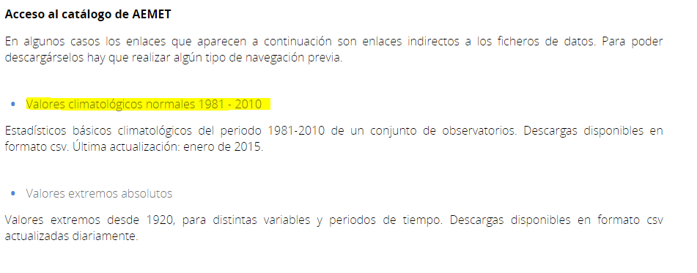
Select data source

Slide 4
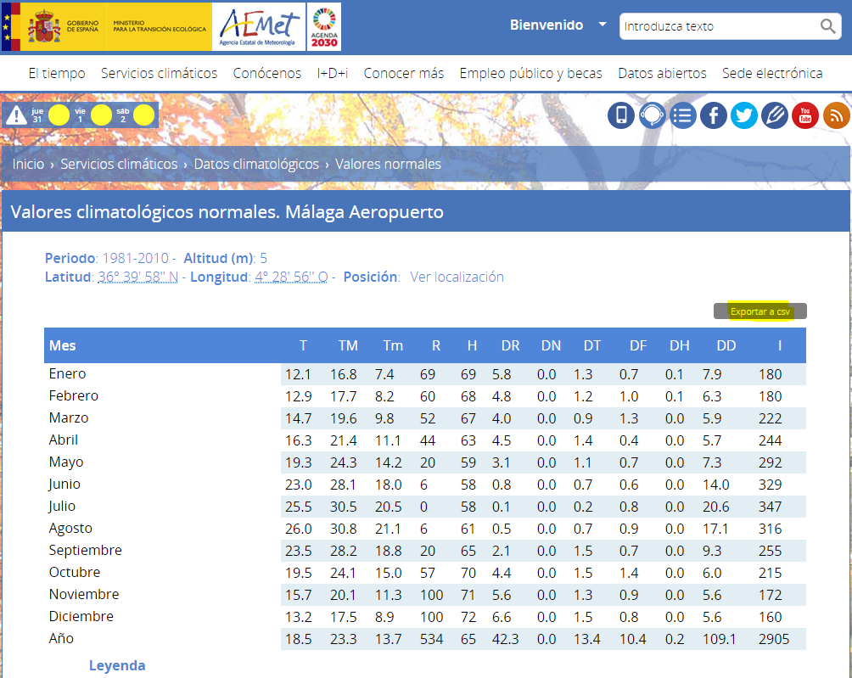
Select cities and download data for our comparison

Slide 5
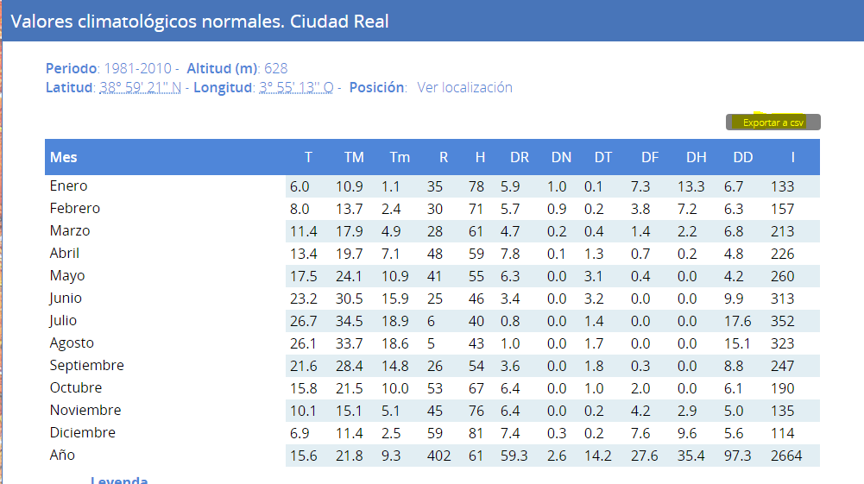

Slide 6
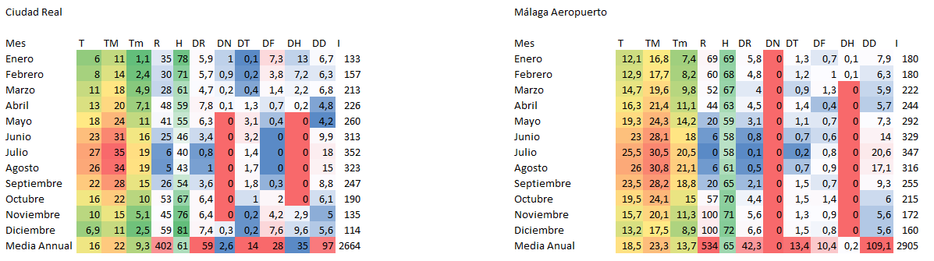
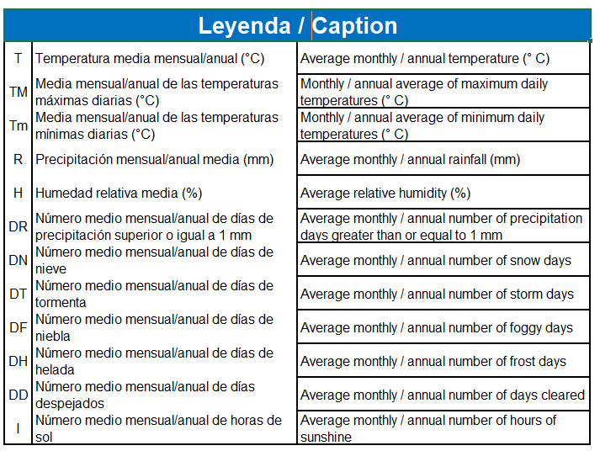
Import data in Excel program. Format them and compare by related columns.

